Slide 1

AI PROJECT
APPLE STOCK PRICE PREDICTION
BY
Medikurthi.Hariprasad
(20691A3117)

Slide 2
INDEX
TOPIC SLIDE NO
Project Introduction 3
Purpose 4
Tools and Technology 5
Dataset 6
Algorithms 7
Conclusion 11

Slide 3
PROJECT INTRODUCTION
Apple stock price prediction using Machine learning.
Stock Price Prediction using machine learning helps us discover the future value of company stock and other financial assets traded on an exchange.
The entire idea of predicting stock prices is to gain significant profits. Predicting how the stock market will perform is a hard task to do.

Slide 4
PURPOSE
It is used to predict the stock price of ‘APPLE’ company for further dates.
Now-a-days stock market has became more popular and source of income for people. With this project it will be helpful for them.
Every predicted output with this model will be more accurate to current stock price.

Slide 5






Slide 6
DATASET
The dataset is taken from a website named Yahoo Finance.
Yahoo Finance delivers hours of live, daily market coverage, with expert analysis and real-time market data . It's the place for insight-driven investors, financial professionals and business leaders .
From this previous 2 years data of “APPLE STOCK” has taken
dated (03-Dec-2020 to 02-Dec-2022).
https://drive.google.com/file/d/1pq9jeODQYW-LceQN-HyMMHzrhvnjQSeE/view?usp=sharing

Slide 7
ALGORITHMS
Three Machine Learning algorithms are used in this project. Based on the accuracy user can use the particular algorithm.
The algorithms are:
1.Linear regression
2. K-Nearest neighbor(KNN)
3. Long short term memory network(LSTM)
https://drive.google.com/drive/folders/1bK4Ie_6XNJpUKZdfC_JpBVxHZwhXEAR3?usp=sharing

Slide 8
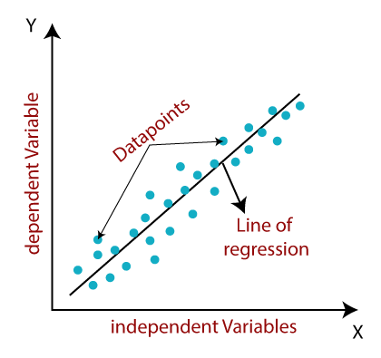
LINEAR REGRESSION
Linear regression is one of the supervised learning algorithm.
Linear regression is one of the easiest and most popular Machine Learning algorithm. It is a statistical method that is used for predictive analysis.
It makes predictions for continuous/real or numeric variables such as sales, salary, age, product price, etc.
The linear regression model provides a sloped straight line representing the relationship between the variables.
Mathematically, we can represent a linear regression as: y=mx+c

Slide 9
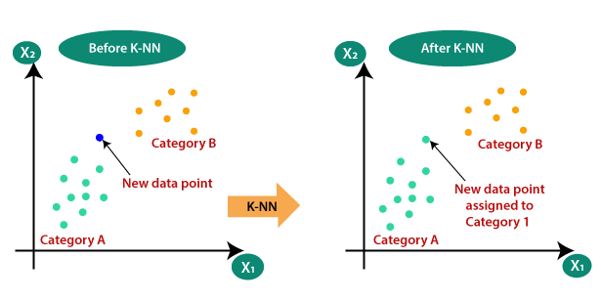
K-NEAREST NEIGHBOURS(KNN)
K-Nearest Neighbour is based on Supervised Learning technique.
It stores all the available data and classifies a new data point based on the similarity.

Slide 10
LONG SHORT TERM MEMORY(LSTM)
Long short-term memory (LSTM) is an artificial neural network used in the fields of artificial intelligence and deep learning.
It is the most complicated and often used algorithm for stock prediction.
LSTM is a special kind of RNN.it is capable of processing the entire sequence of data, apart from single data points.

Slide 11
CONCLUSION
This Machine learning model predicts the stock prices of apple company with high accuracy.
With this model the user can predict and trade to make profits from APPLE company stocks.

Slide 12
THANK YOU

